Slide 1
DEPTH ESTIMATION of an image
BATCH-10A
K .Sravani - 314126510049
M. Durga prasad - 314126510060
B. Pavan kumar - 314126510010
E.Uday kumar - 314126510019
Under guidance of santhoshi

Slide 2
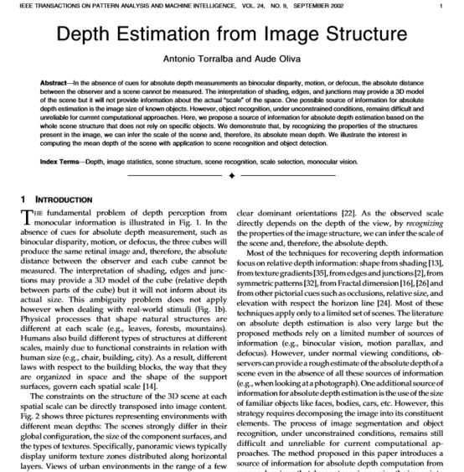
BASE PAPER

Slide 3
ABSTRACT
The depth of an image is used to find out the distance from where it is taken. This is done by taking a set of images with different depths as the input and extracting useful features from it i.e., training of the dataset. The trained dataset thus obtained are used for testing new data . The trained data is then used to calculate the depth of any image approximately.

Slide 4
Problem statement
In the absence of cues for absolute depth measurements as binocular disparity ,motion, or defocus, the absolute distance between the observer and the scene cannot be measured. One possible source of information for absolute depth estimation is the size of known objects. However ,object recognition ,under unconstrained conditions ,remains difficult and unreliable for current computational approaches.

Slide 5
INTRODUCTION
Depth estimation or extraction refers to the set of techniques and algorithms aiming to obtain a representation of the spatial structure of a scene.
By recognizing the properties of the structures present in the image, we can infer the scale of the scene and, therefore, its absolute mean depth.

Slide 6
EXISTING AND PROPOSED SYSTEM
In our project the existing system does image feature extraction (global and local features) for known depths images and probabilistic model is used to train the data set and after using a new image of unknown depth, depth is estimated.
In our project the proposed system would be the image feature extraction same as of existing and also training of data set will be first done using probabilistic model algorithm. For further training of dataset will be replaced by SVM or Random forest algorithm instead of probabilistic model, and finally the depth of new image is calculated or predicted.

Slide 7
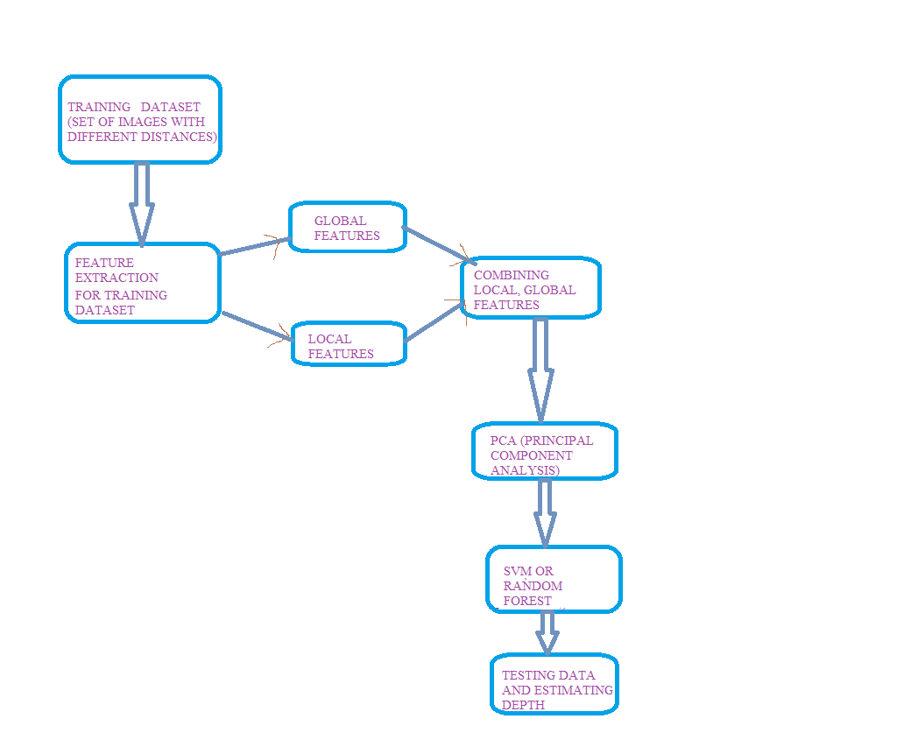
ARCHITECTURE

Slide 8
PRE-PROCESSING TECHNIQUES
The first pre-processing technique used is to convert image from RGB to grayscale.
After that we apply filters so to obtain sharp edges and for better computation results.
Then we apply sharpening technique for that we use negative Laplacian filter.
Then will resize the image accordingly to our desired value.

Slide 9
Feature extraction
1.In our project two types of features are extracted from the images based on the application, they are global and local features.
2. Global features are generally used in object detection and classification.
3. Local features are used for object recognition/identification.
4. In this project for finding global features we used fast fourier transform(FFT) and for local features we used windowed
fourier transform to get details at particular location.

Slide 10
Principal component analysis
1. The main purpose of PCA is to reduce the dimension of the dataset with minimal loss of information.
2. . Principle component analysis is also known as dimensionality reduction algorithm which reduces n dimensional to some d dimensional form for example if n=3 then d can be of any value either 2 or 1
3. Here in our project after feature extraction we reduce the output data which is in the form of 2 dimensional is converted into 1-Dimensional form by applying PCA algorithm. The PCA is mostly used so that we can reduce the computation part for our image

Slide 11
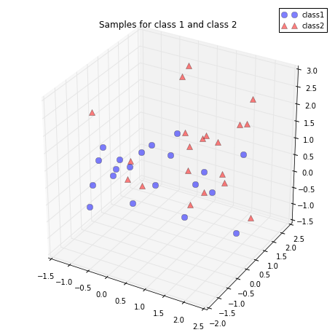
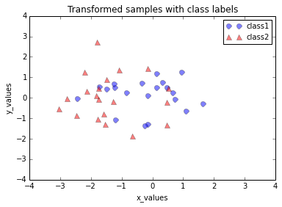

Slide 12
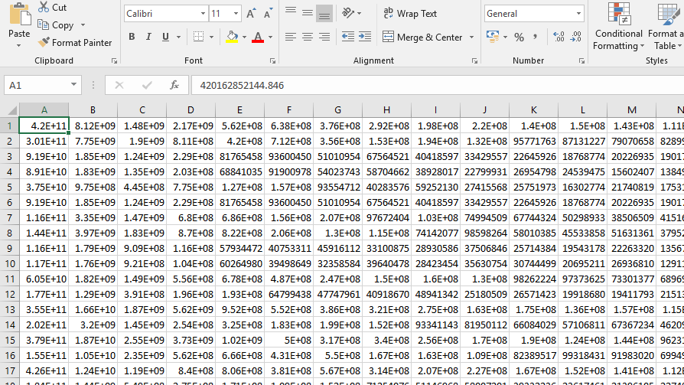
Data storage

Slide 13
Support vector machines
1. Support Vector Machine” (SVM) is an algorithm which is used for testing of the trained data which can be used for both classification or regression challenges.
2. In this algorithm, we plot each data item as a point in n-dimensional space (where n is number of features you have) with the value of each feature i.e.,local and global features, being the value of a particular coordinate.
3. For a new image we will predict the output using the trained data set.

Slide 14
Random forest
Random forest is the extension of the decision trees which is also called the bagged model.
Here multiple decision trees are created using the random selection of variables .
Finding the probability of all the trees, the optimised tree is considered and is considered as the best model.

Slide 15
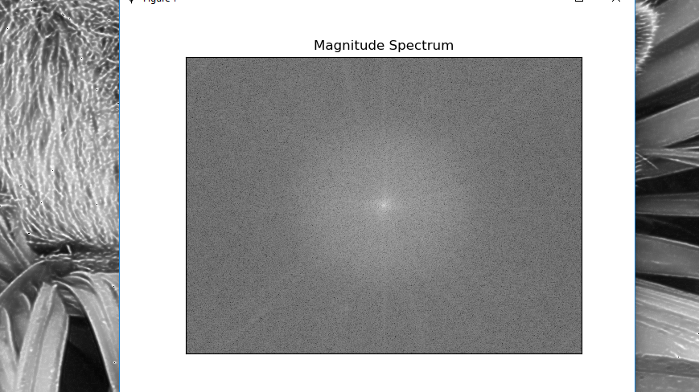
Result of features: global Features

Slide 16
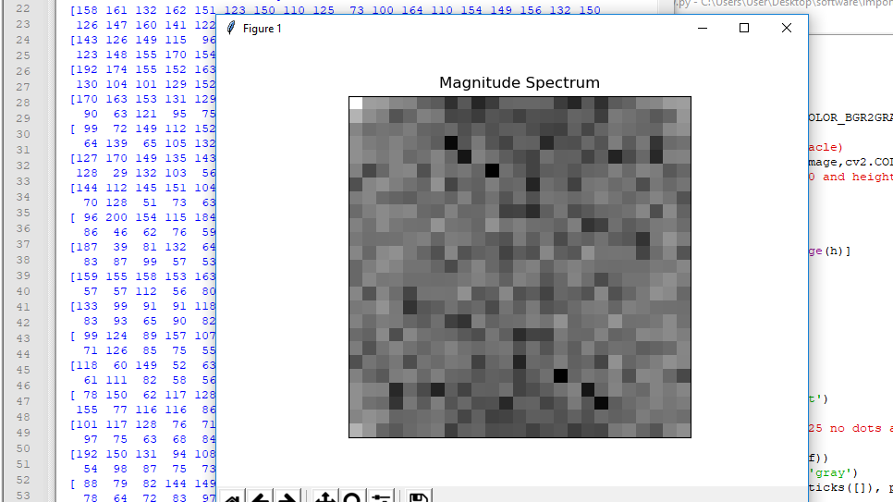
Result of local features

Slide 17
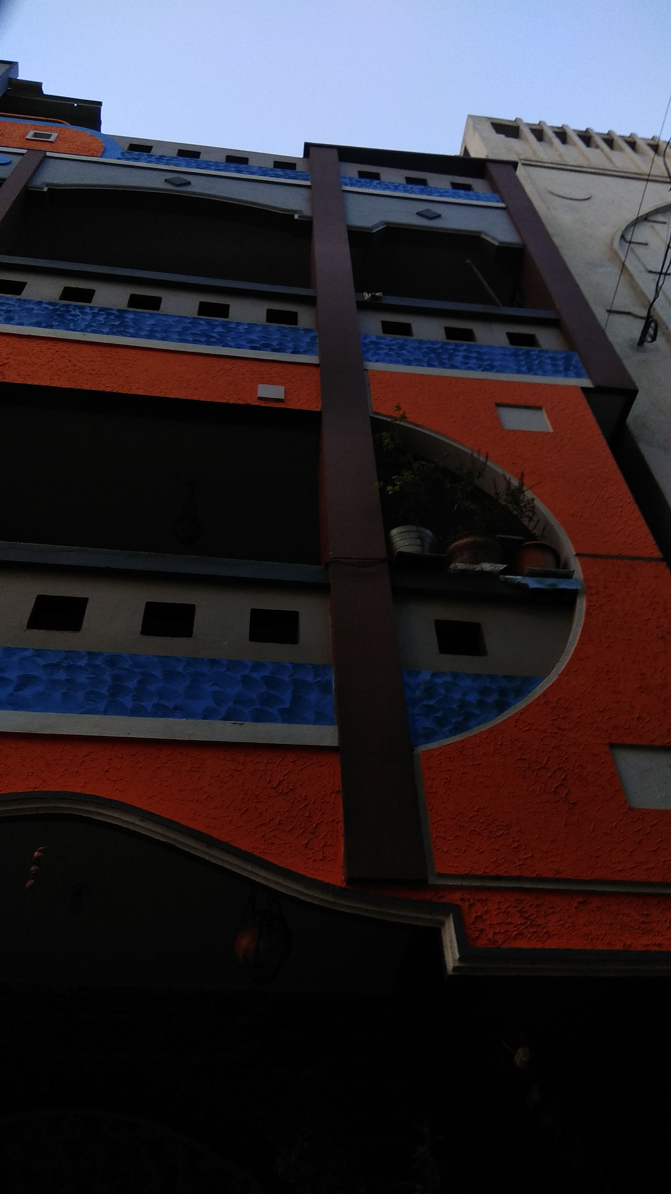
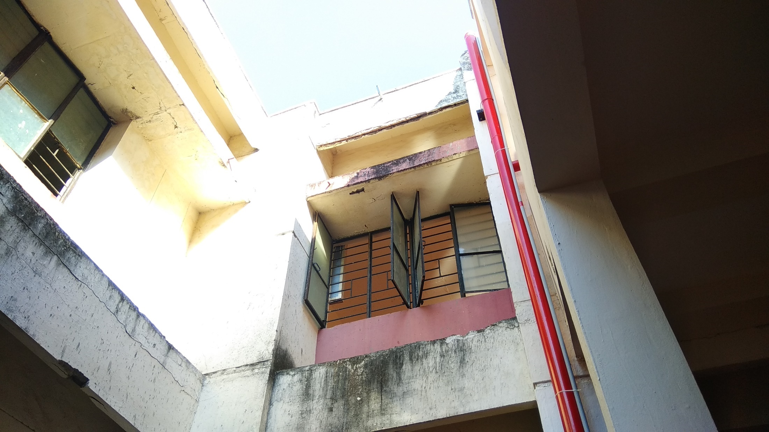
Input: Testing images

Slide 18
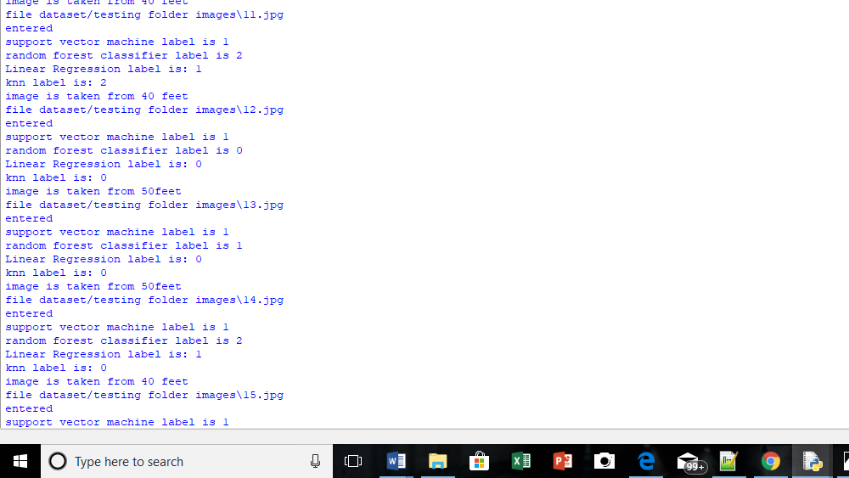
result

Slide 19
CONCLUSION
The final aim of the project is to estimate the depth of an image by performing training of dataset containing images and storing them in files, and the testing the new data and roughly predicting the depth using machine learning algorithm SVM OR Random forest classifier using python programming language and found that random forest classifier gives more accuracy when compared to support vector machines.

Slide 20
ANY QUIRIES ?

Slide 21
THANK YOU

